Slide 1





The Wiring Underneath: Developing an Interactive “Economy” in Youth Environmental Education Software
Presenter: James Vancel
Space Grant Mentor: Barron J. Orr, PhD
Space Grant Symposium, University of Arizona
April 21, 2012
Special Acknowledgments: Kristin Wisneski, Nicholas Knutson, Irene Liang
Funding for this work was provided in part by NASA Space Grant and in part by USDA. The research and the development of the Akshen.org application suite are being supported by the U.S. Department of Agriculture (USDA) National Institute of Food and Agriculture (NIFA) National Research Initiative grant #2009-55215-05187.

Slide 2

Context: Economy in Society
Guiding institutions
  Property Rights
  Specialization
  Currency
  Etc.
Manifesting in “virtual worlds”

Slide 3



Background: Existing Virtual Worlds
Dominant Characteristics:
Transferability
Specialization
Mobility
Public Acclaim and Recognition of Achievements
Inflation / MUDflation
“Beatability”
Competition
Investment
http://secondlife.com/
http://www.eveonline.com/
http://us.battle.net/wow/en/

Slide 4
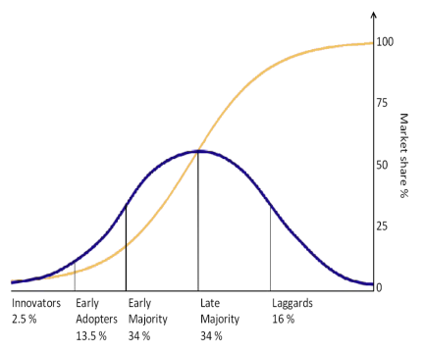
Problem: Promoting Spread while Maintaining Learning Objectives
Current Diffusion
Minimal
Program Leader Oriented
Top-Down
Forced
Desired Diffusion
Past Critical Point
Program to Program
Bottom-up
Self-Guiding
Critical Point
Desired Diffusion
Present Diffusion

Slide 5
Problem: Promoting Spread while Maintaining Learning Objectives
“Opportunities to learn” are not enough today…
  Problem-based Learning theory offers a framework
  Youth need a self-guided, constructive and goal-oriented framework for learning how to identify and solve problems using our Akshen toolkit.
  We need a trigger to hook the youth and make them aware of the problems around them independently
Centered around a “scaffolding approach”
  “Rewards” make the pursuit more fun/challenging

Slide 6
Solution: Wiring a Virtual “Economy”
Legend:
Scaffolding Process
Learning Outcome
Economy Process
Economy Outcome

Slide 7
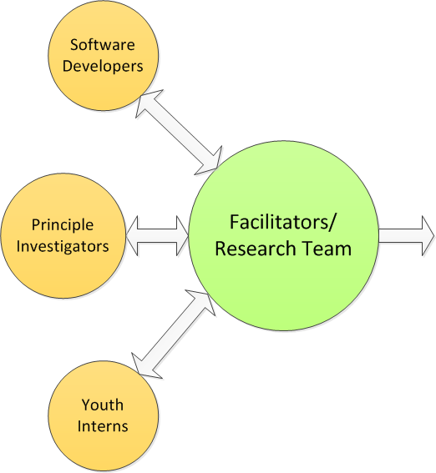

Experimental Design

Slide 8

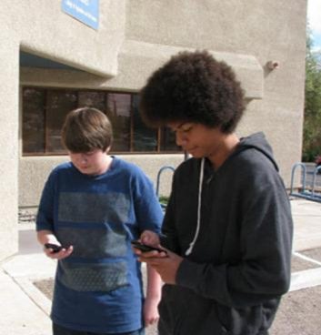
Methods: Intern Focus Group Discussions
Desired:
Tangible Rewards
Transferability
Challenges
Group Competition
Publication of Progress
Power/Responsibility
Engaging Software
Unlockable Items

Slide 9
Structure: Flow
Legend:
Scaffolding Process
Learning Outcome
Economy Process
Economy Outcome

Slide 10
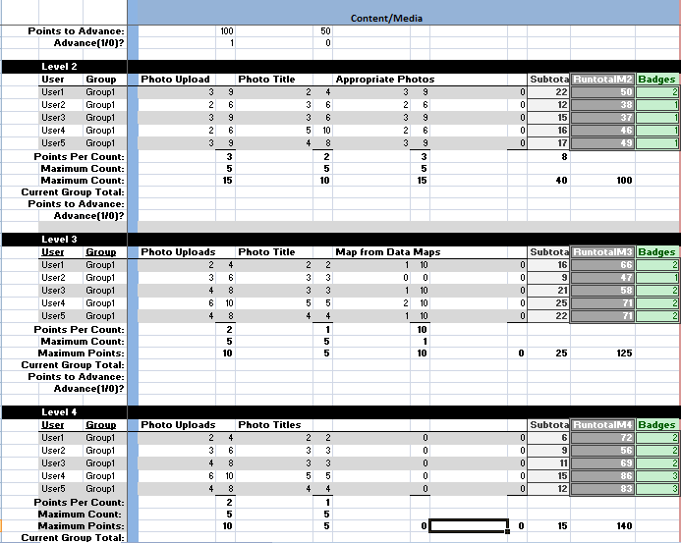
Structure: Financial System

Slide 11

Badges for Self-Assessment
Animator (Media/Content)
Luminary (Ideas/Brainstorming)
Connector (Collaboration)
Entrepreneur (Leadership)
Ambassador
(Communication/Participation)
Catalyzer (Action)

Slide 12
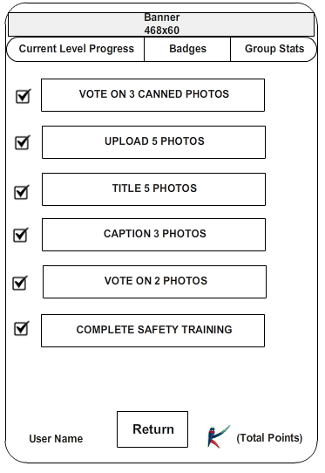
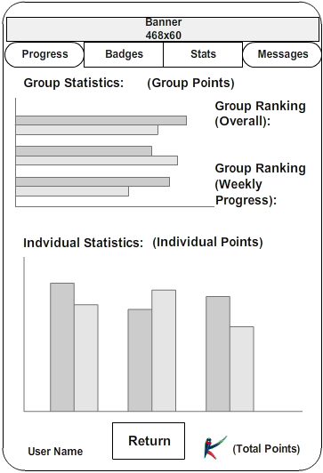
Results: Group-Focused Approach

Slide 13
Conclusions
Preliminary results show:
  An internal economy incentivizes participation and promotes spread.
  Negative externalities (unhealthy competition, rivalry, stratifying members) can be minimized, if accounted for in advance
  The economy can actually promote several learning outcomes
    Accountability
    Responsibility
    Skill-sets
    Self-assessment

Slide 14
Conclusions
Many characteristics of “virtual economies” can be applied to learning software and thus applications of virtual economies should be encouraged, albeit tactfully in educational software.

Slide 15



Acknowledgments
Ironwood Tree Experience
    Poli Joshevama
    Alegria Gray
    Katie Martinez
    Matt Clark
    Bernd Steklis
    Wulf Steklis
Downtown YMCA
Darius Dumel
Northwestern YMCA
    Jordie Farias
    Stacie Tomlin-Brown
    Chesalon Walton
Skrappy’s Youth Center
    Alex Contreras
    Alfonzo Contreras
    Austin Kerg
Barron Orr, PhD
Kristin Wisneski
Nicholas Knutson
Irene Liang
Nirav C. Merchant
Damian Hammond
Dave Parizek
Stealth Health Investigators
Arizona Space Grant Consortium
United States Department of Agriculture (USDA)
Arizona Remote Sensing Center
Office of Arid Land Studies
Arizona Research Laboratories/Bio 5 Institute

Slide 16

Thank You!

